Slide 1
SeedSmart
Fellow Kids Adrián Fekete Sándor Angyal
Data-driven Agriculture

Slide 2
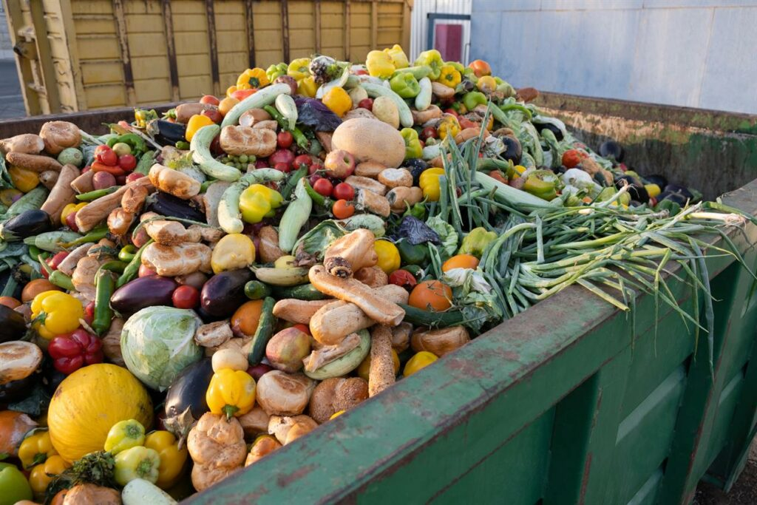
Agriculture’s Dual Challenge: Uncertainty & Waste
Difficult to predict which crops are profitable
Overproduction → price drop, food waste
Poor decisions → economic and environmental losses
Farmers need data-driven decision support

Slide 3
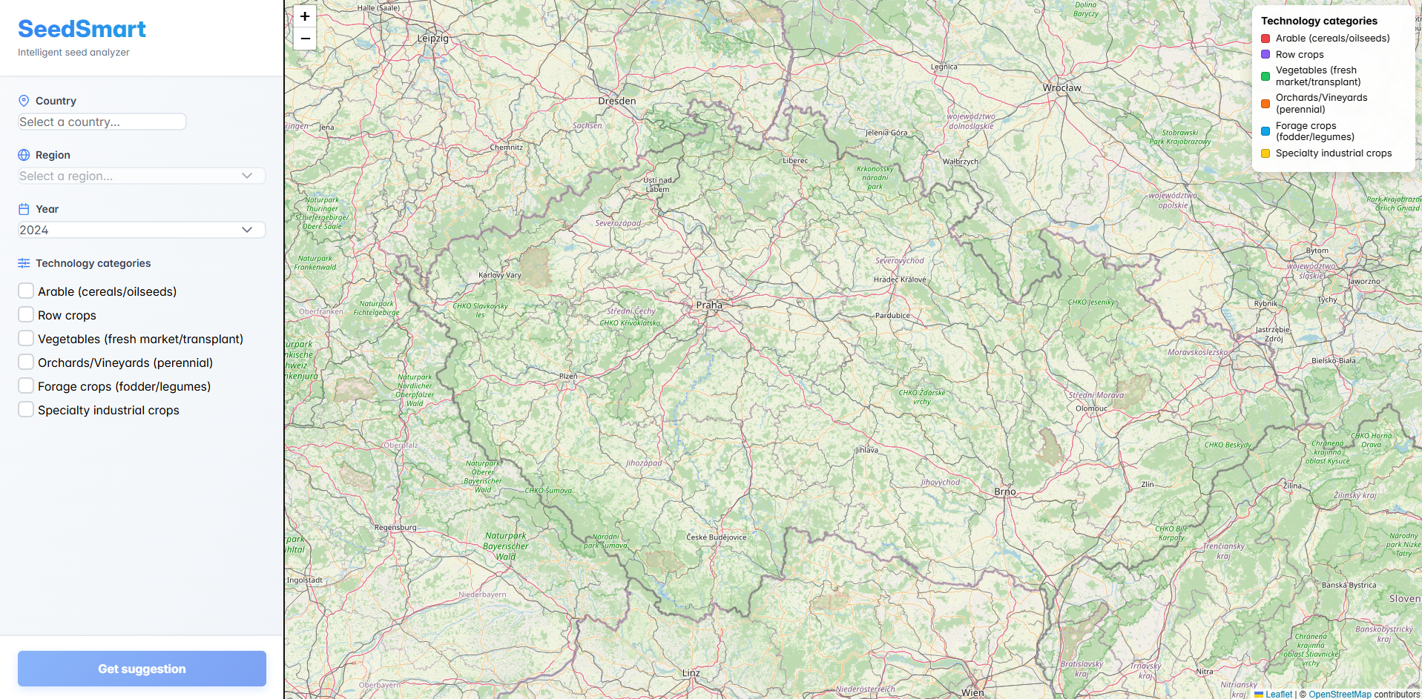
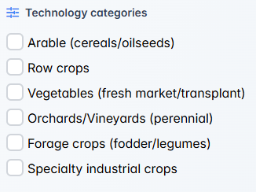

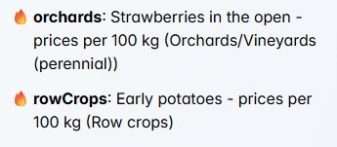


Solution
User-friendly page
Cultivation technology types
High-yield crops history
Filters
Prediction

Slide 4
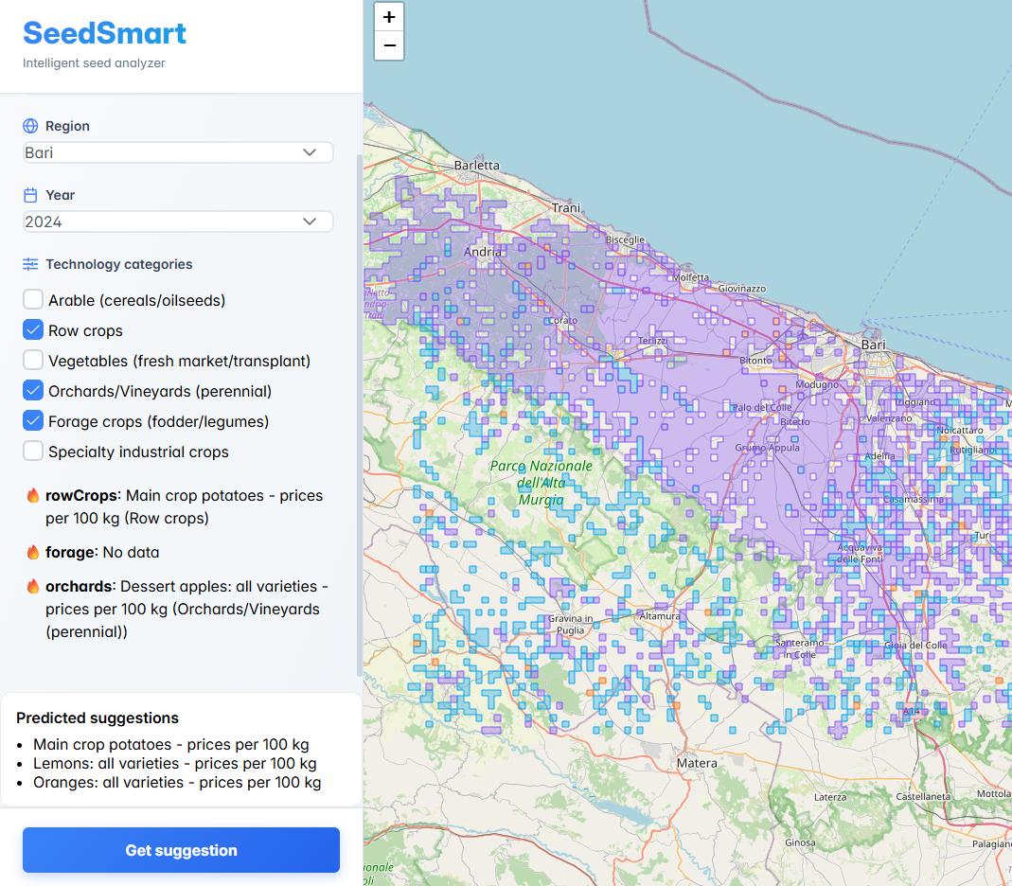
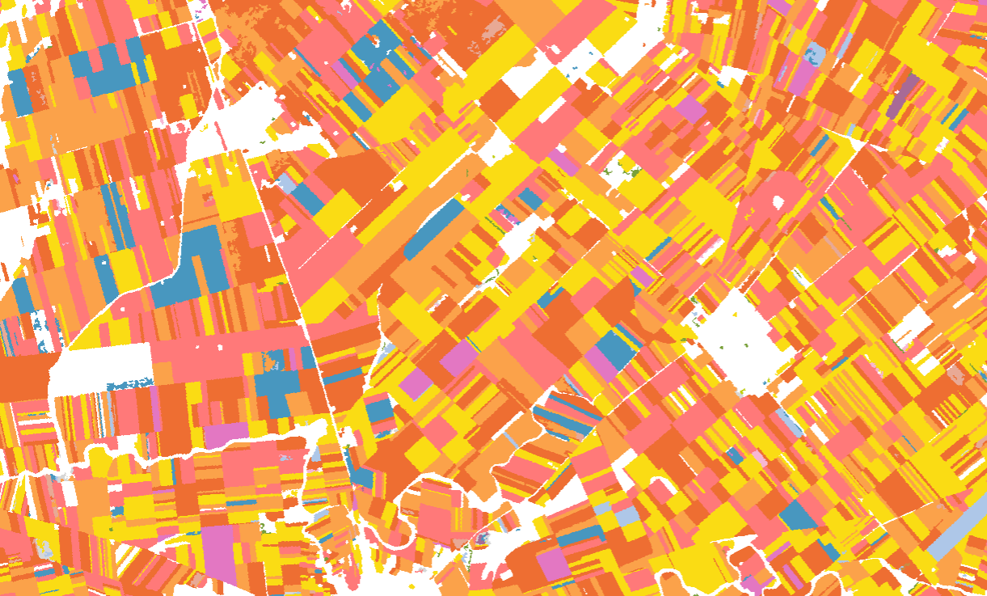
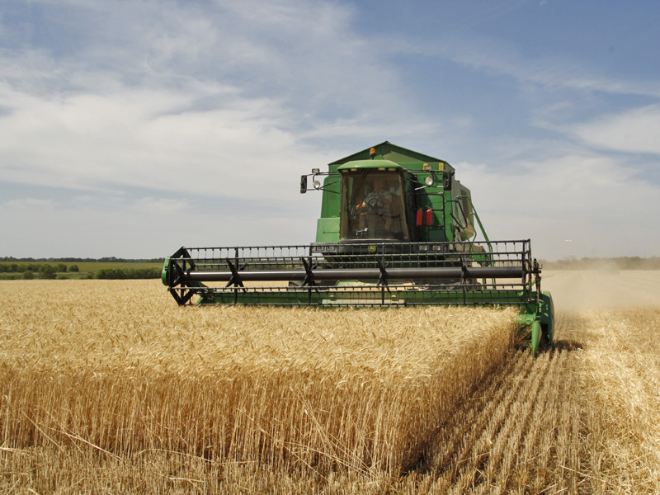
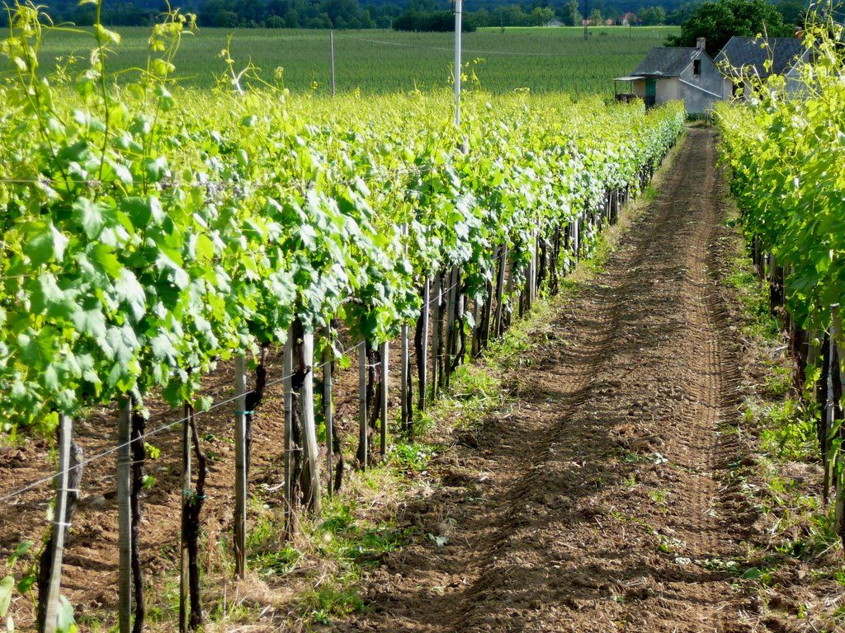
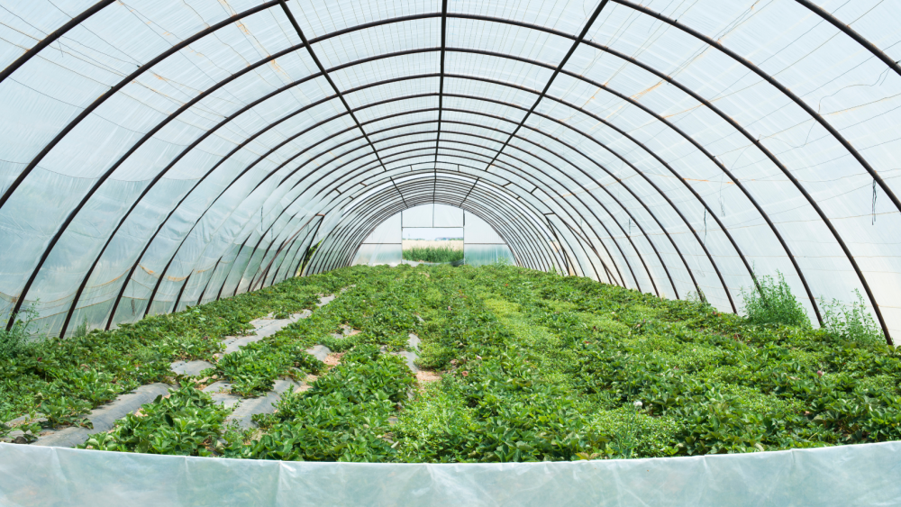
Solution
Rivals
Farm machinery and infrastructure
EU Copernicus Services Catalogue

Slide 5
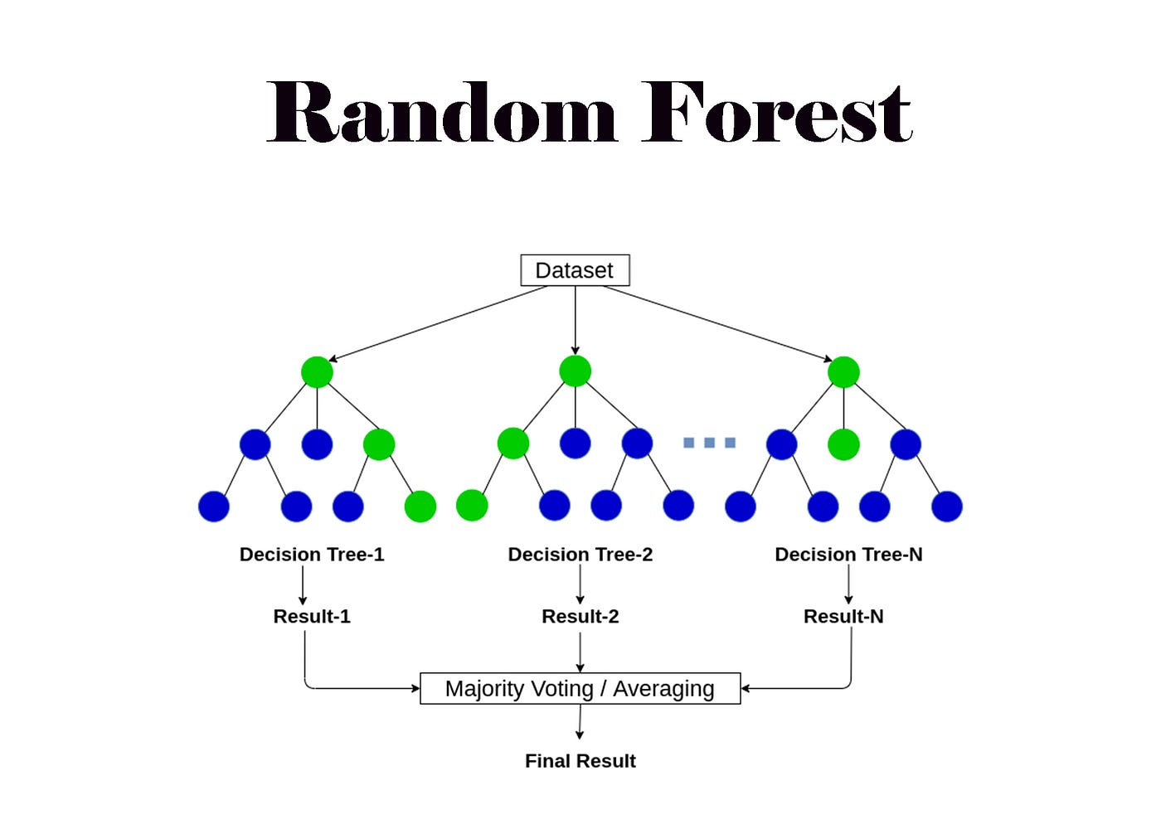
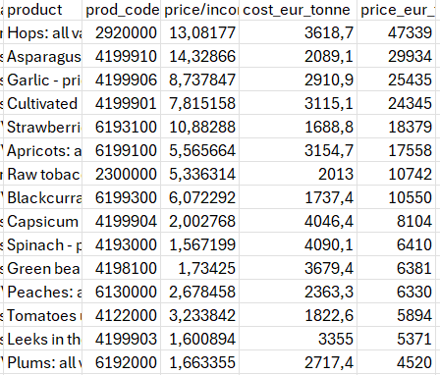
Prediction
Random Forest Tree
Data since 2000
Forward-looking insights

Slide 6


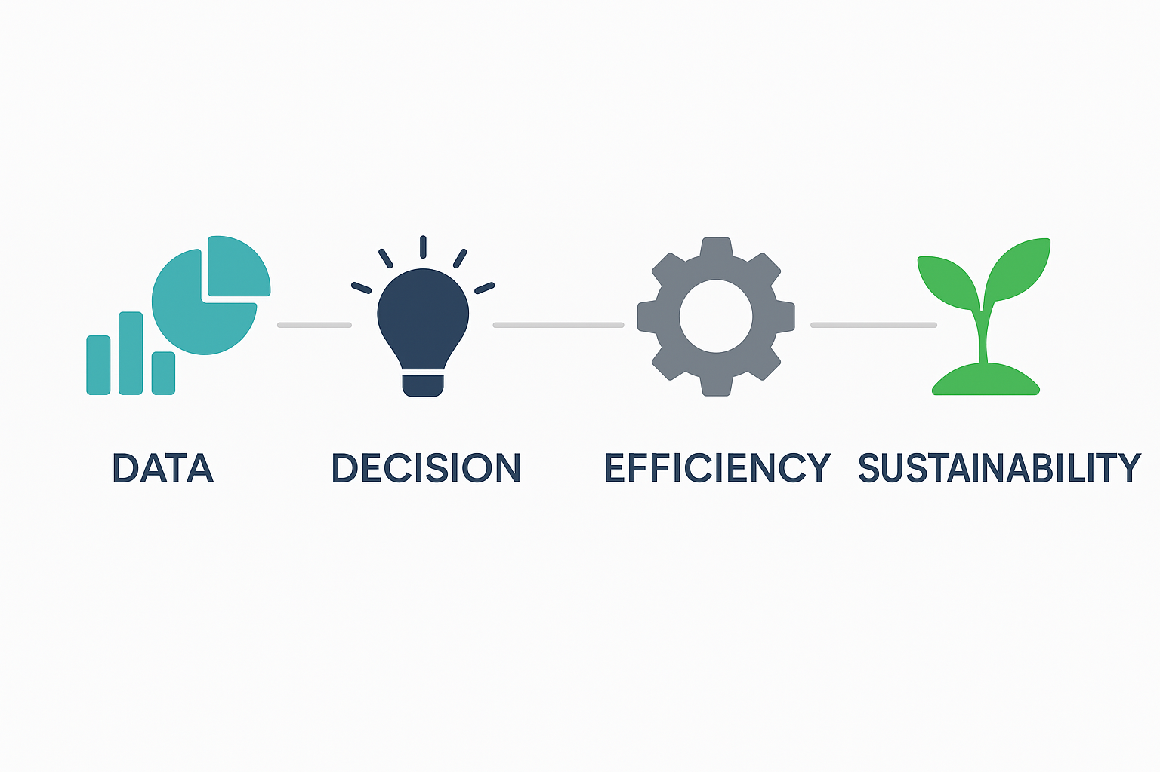
Social and environmental impact
Overproduction prevention
Waste & resource cuts
Sustainable land use
Economically efficient, ecologically responsible

Slide 7
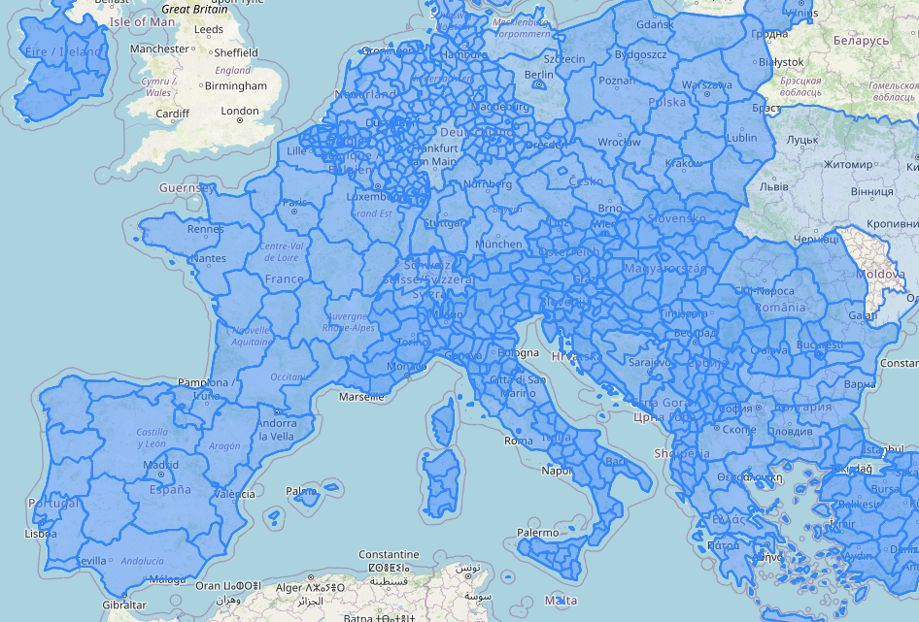
Prediction
Country-specific data
Soil moisture
Soil type
Minerals
Profit

Slide 8

T
THANK YOU FOR YOUR ATTENTION

